Slide 1
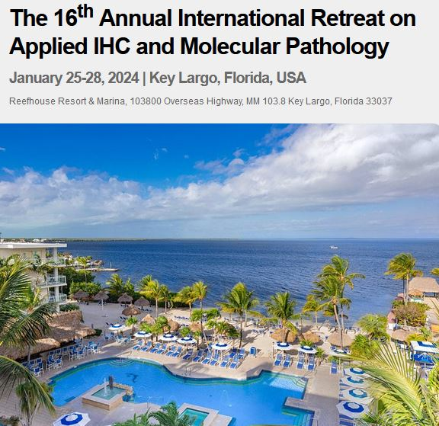
“Confirmational Proteomics ….. Is It Time?”
Richard W. Cartun, PhD, MS
Morphologic Proteomics, LLC
mproteomics1@gmail.com
rcartun@sbcglobal.net
(860) 490-7633 Cell

Slide 2
“Confirmational Proteomics ….. Is It Time?”
Richard W. Cartun, PhD, MS
Director, Histology & The Martin M. Berman, MD Immunopathology and Morphologic Proteomics Laboratories
Department of Pathology
Hartford Hospital
Hartford, CT USA
(July 1978 - June 2022)

Slide 3
“Confirmational”
Wiktionary - “….. of or pertaining to the confirmation of one theory or observation by others”

Slide 4
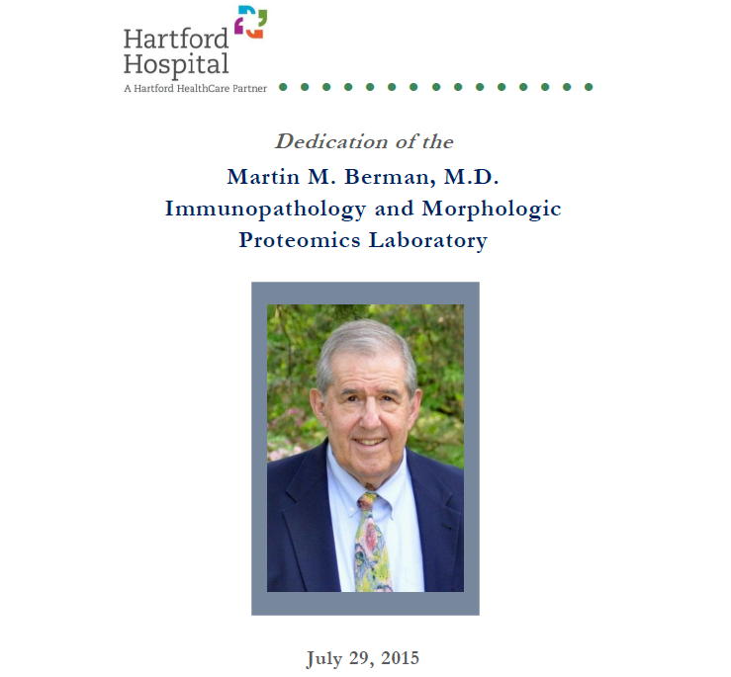

Slide 5
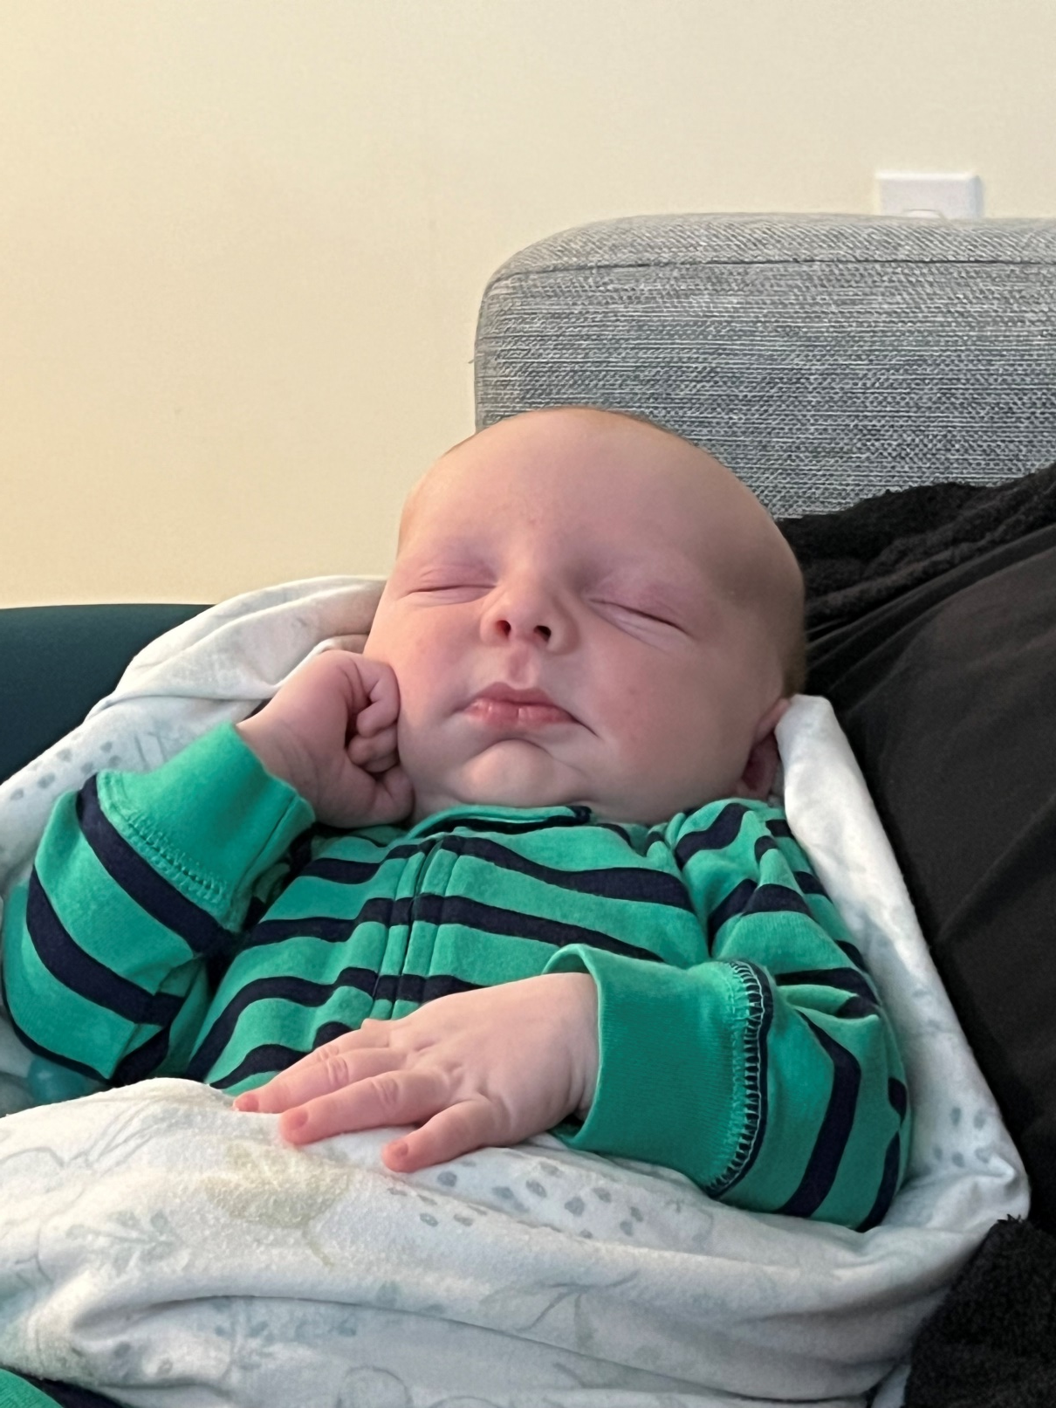

Slide 6
Diagnostic Pathology
H&E stain (1865)
Histochemical stains (1870’s)
Electron microscopy (1931)
Immunohistochemistry (1941)
Flow cytometry (1968)
Molecular techniques (1983)

Slide 7
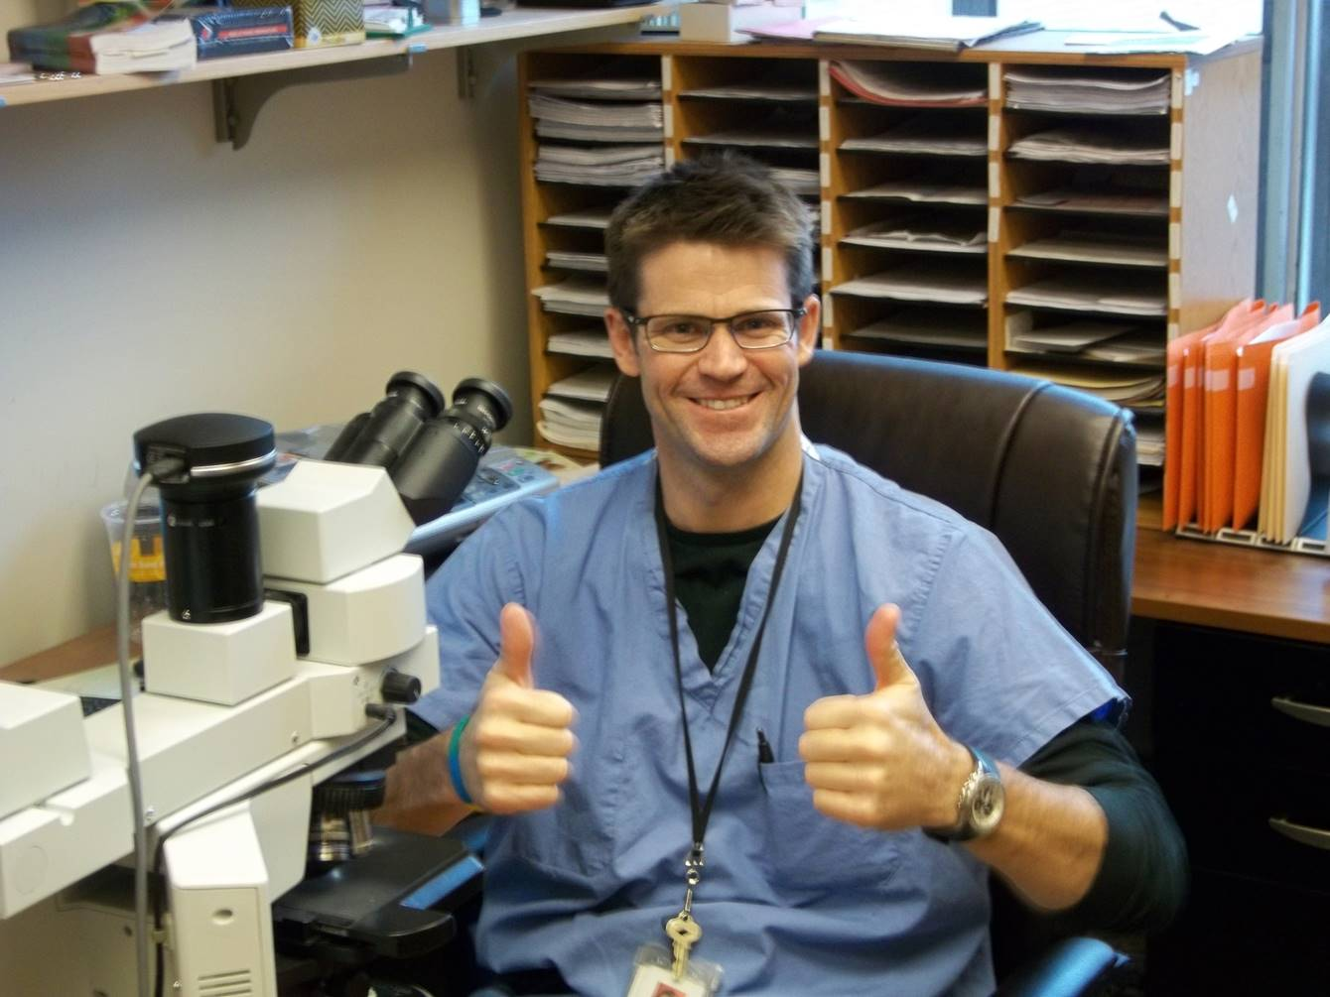

Slide 8
IHC

Slide 9
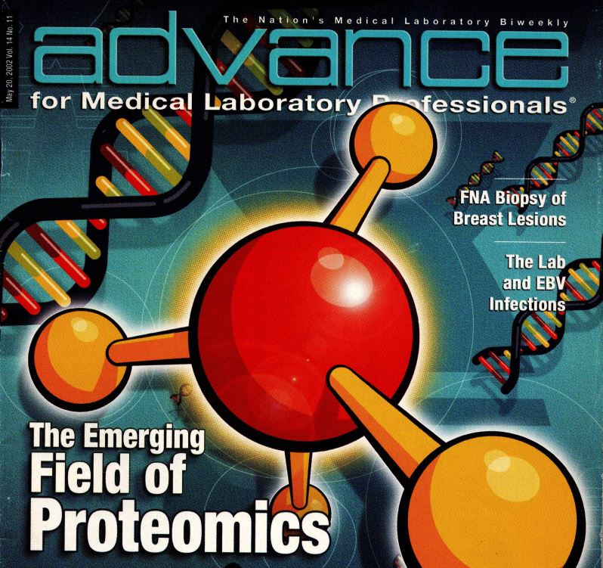
May 2002

Slide 10
Dr. Clive R. Taylor

Slide 11
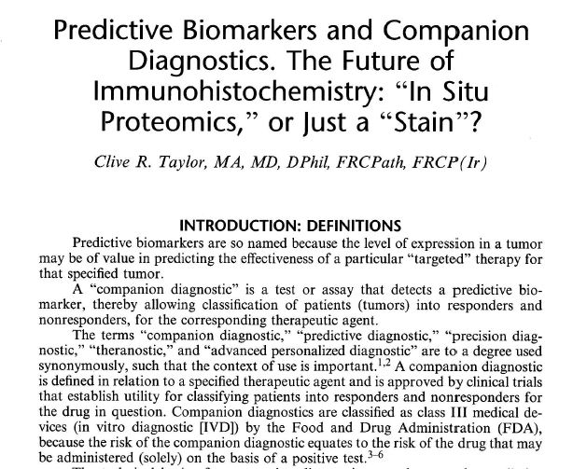

Slide 12
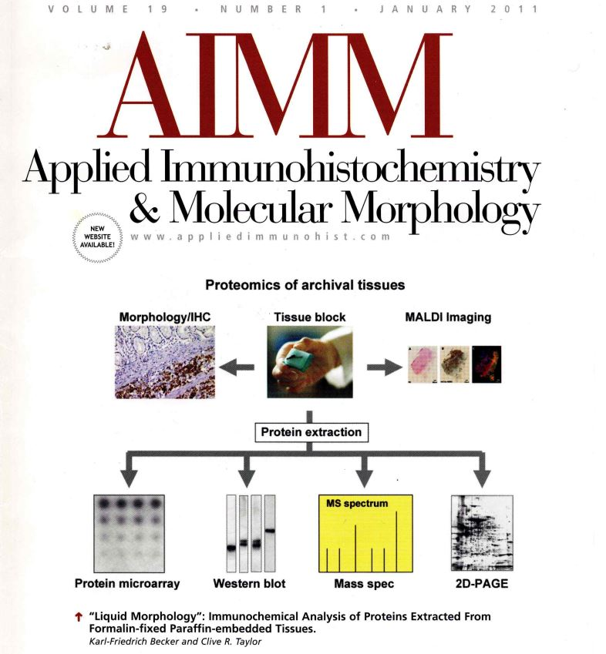

Slide 13
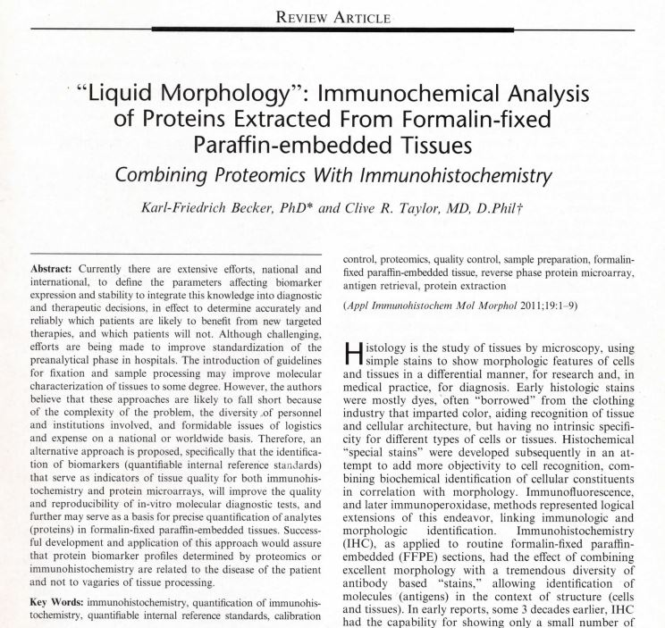

Slide 14
“Immunohistochemistry”
“….. is a test!”
Technique used to identify a target antigen (protein) in cells or tissue section using a primary antibody and a detection system that produces a visualization product seen under a microscope.

Slide 15
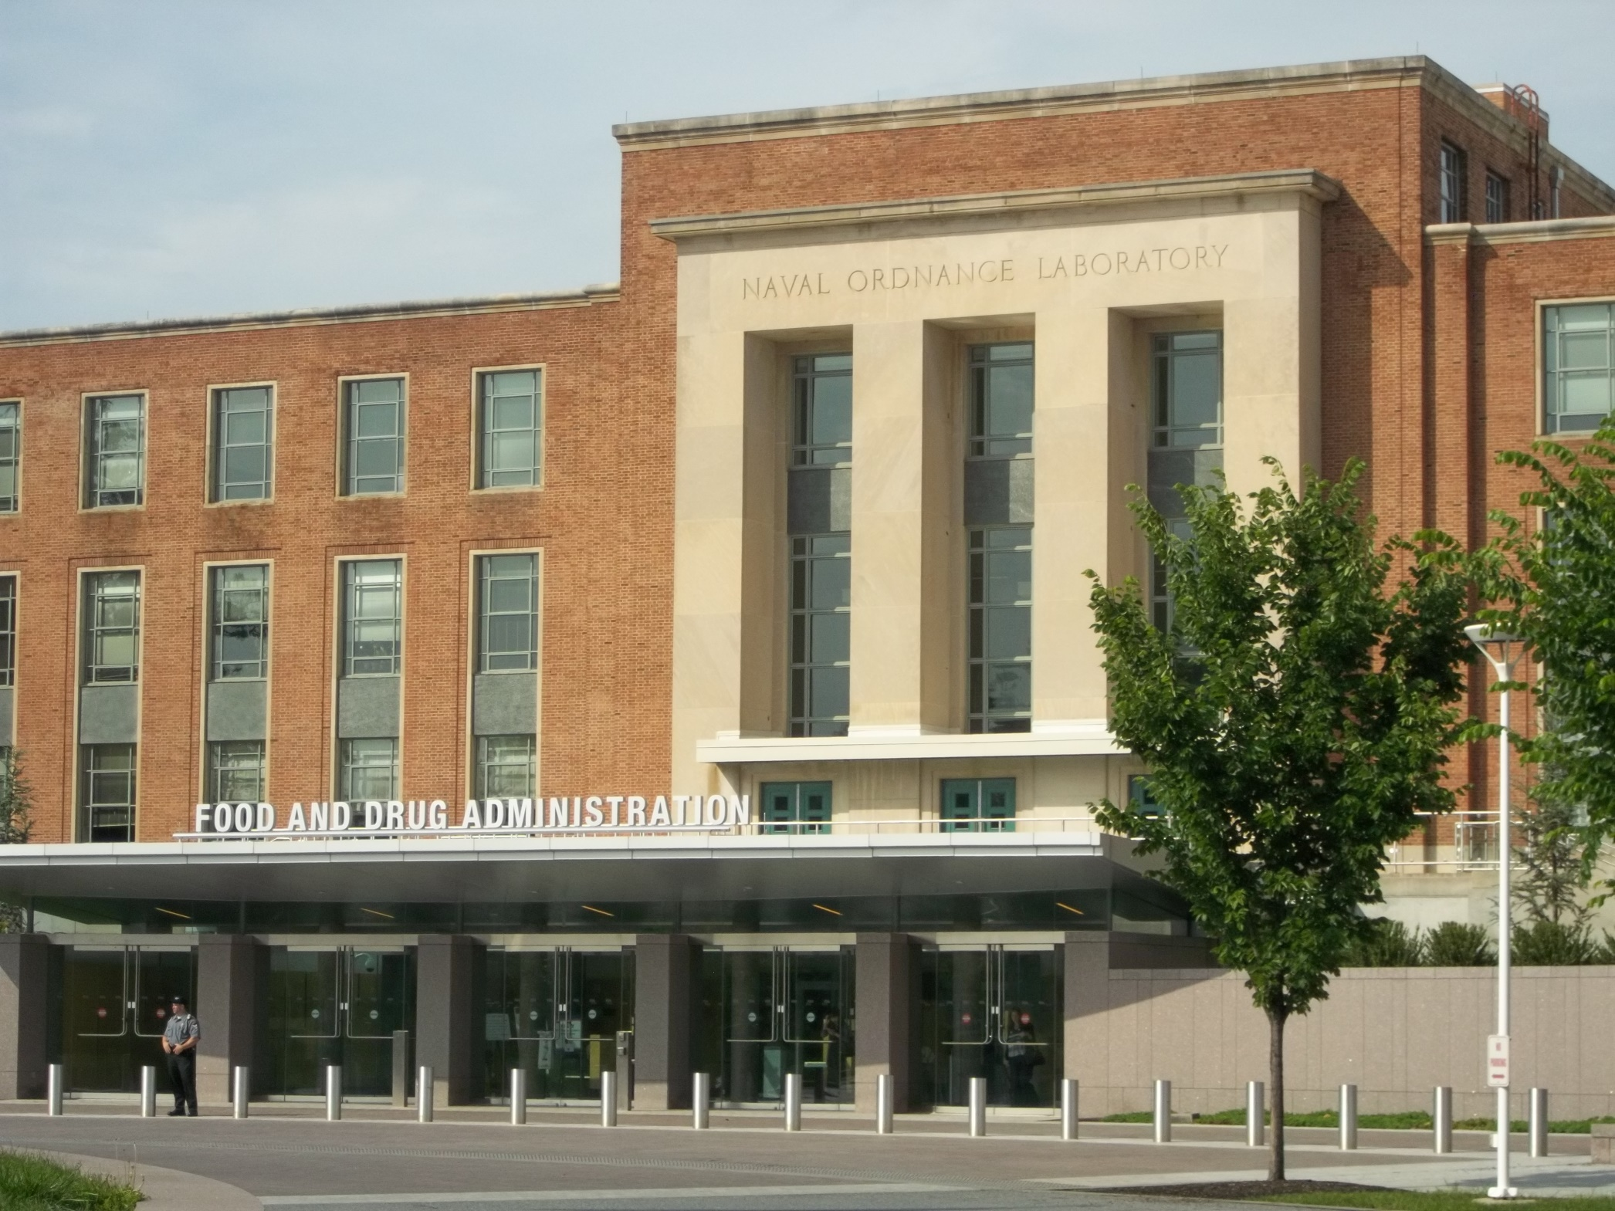
“Morphologic Proteomics”
“Proteomics in the Clinic”
June 13, 2014

Slide 17
“Beyond the genome, protein expression is the last critical evidence needed to treat a tumor effectively.” - NantHealth

Slide 18
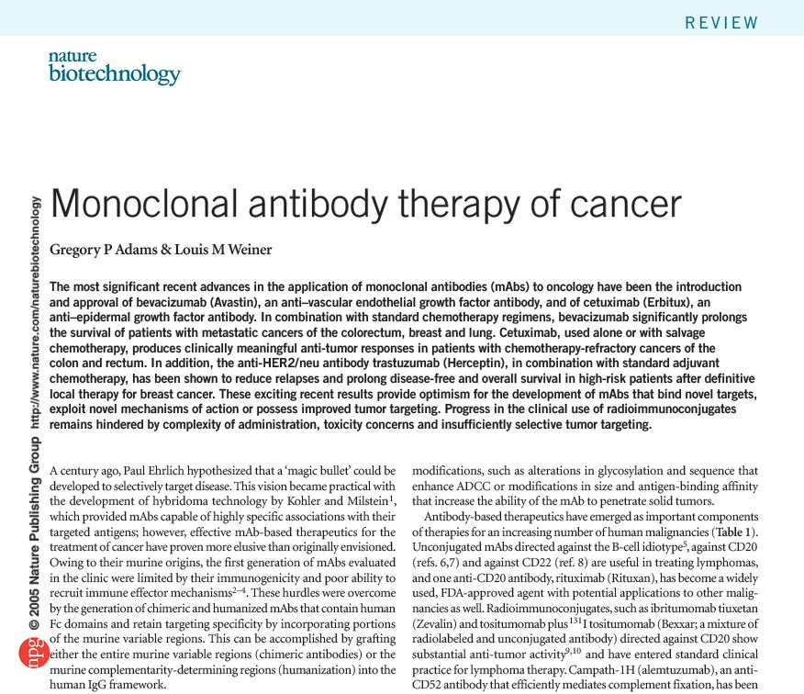

Slide 19
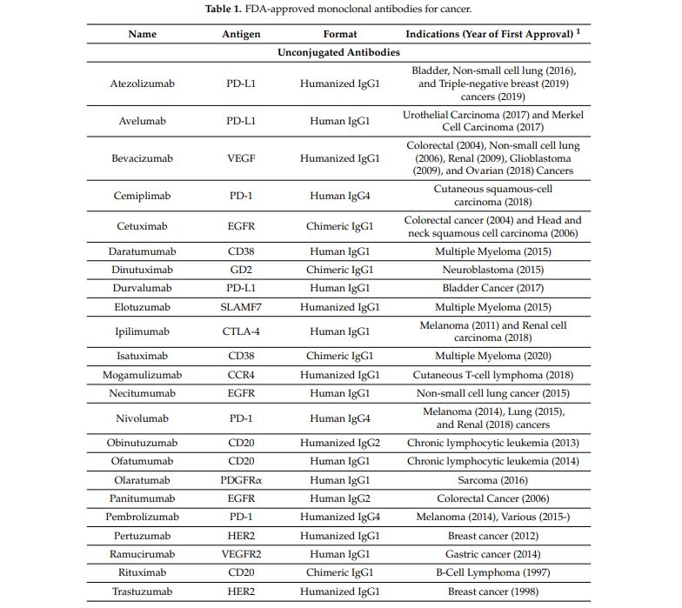
“………. mab”

Slide 20
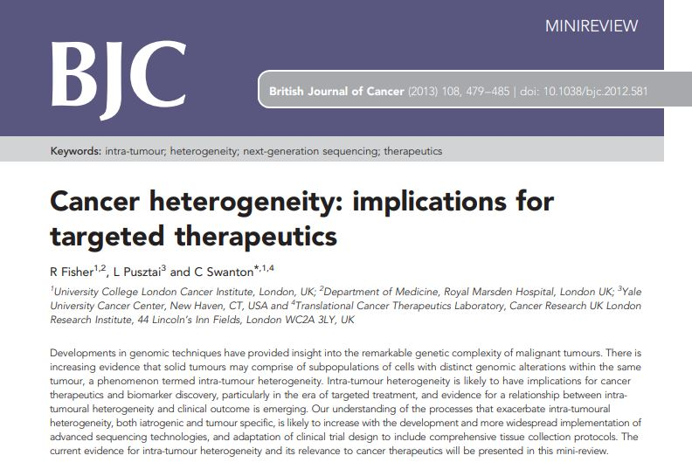
“There is increasing evidence that solid tumours may comprise of subpopulations of cells with distinct genomic alterations within the tumour, a phenomenon termed intra-tumour heterogeneity.”

Slide 21
“Tumor Heterogeneity”
Eva Kiesler - MSKCC July 2, 2014 “What is tumor heterogeneity?”

Slide 22
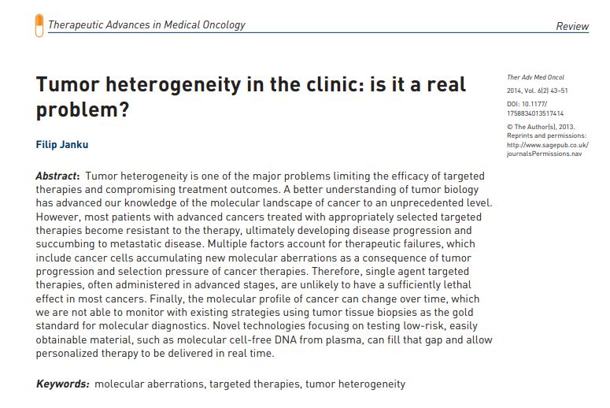
“Therefore, single agent targeted therapies, often administered in advanced stages, are unlikely to have a sufficiently lethal effect in most cancers.”

Slide 23
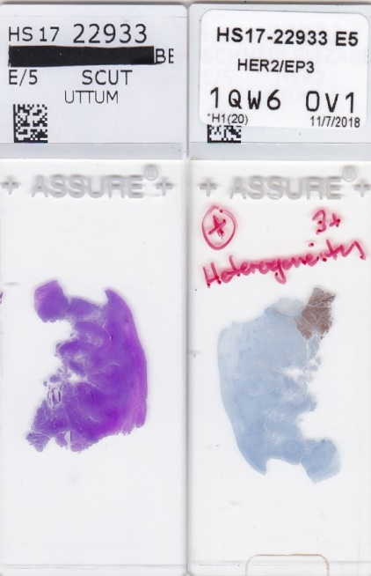

Slide 24
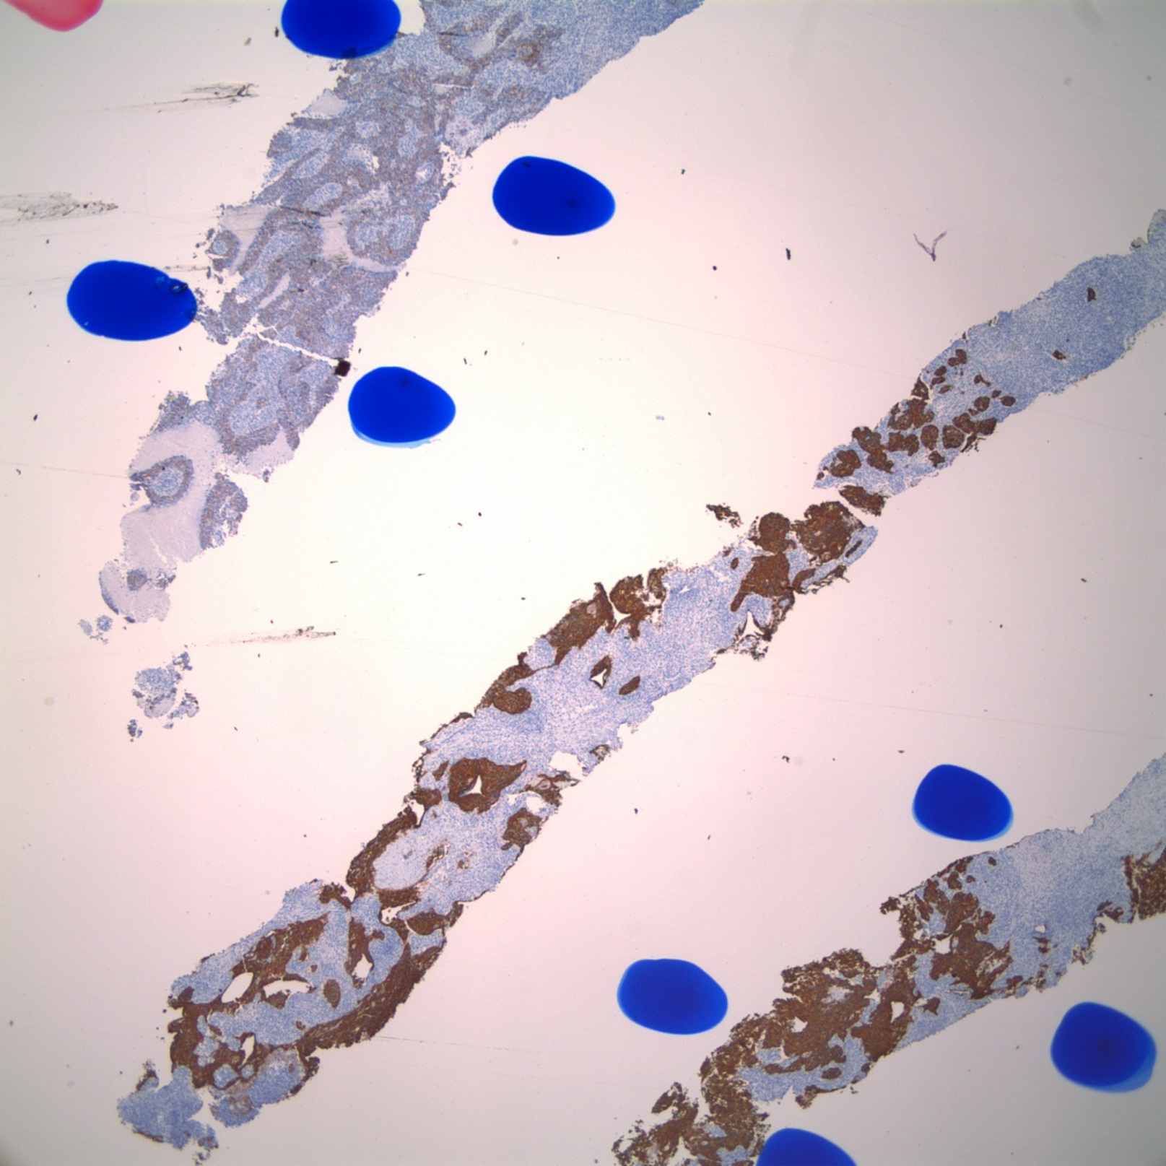
HER2 IHC 4x

Slide 25
“HER2 Heterogeneity”
HER2 (-) clone
HER2 (+) clone

Slide 26
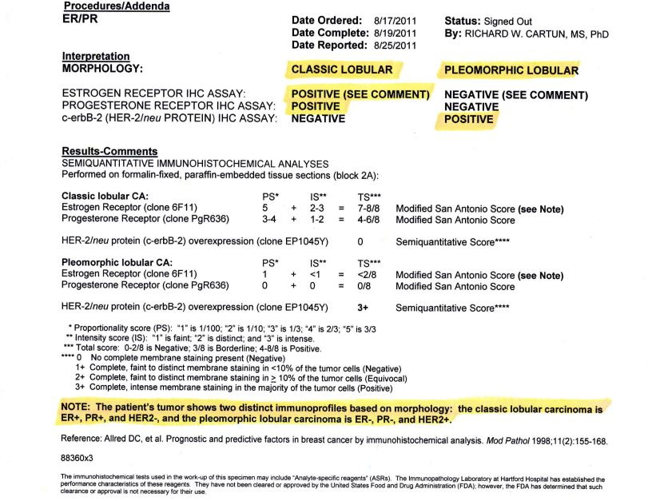

Slide 27
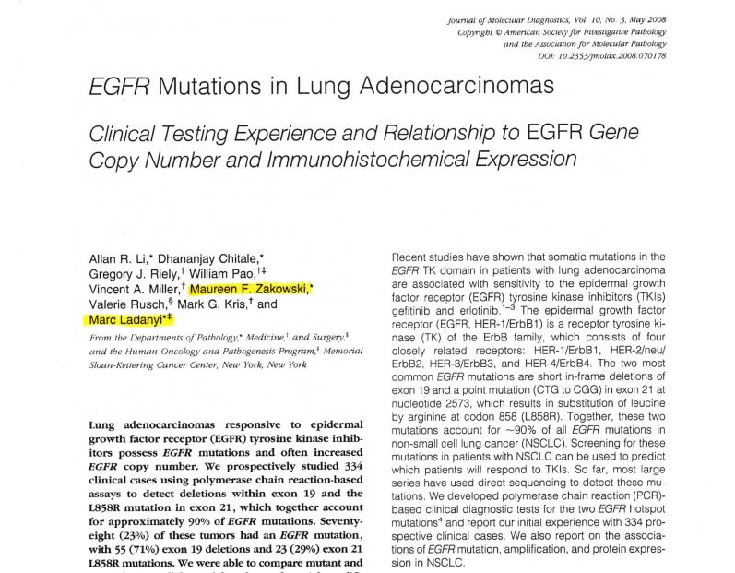

Slide 28
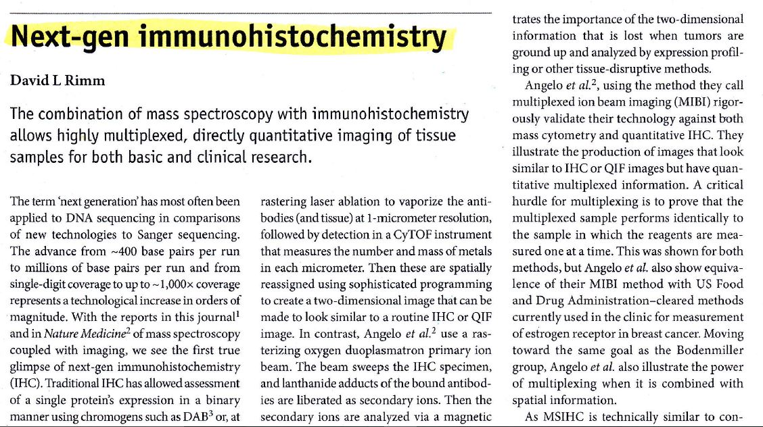

Slide 29
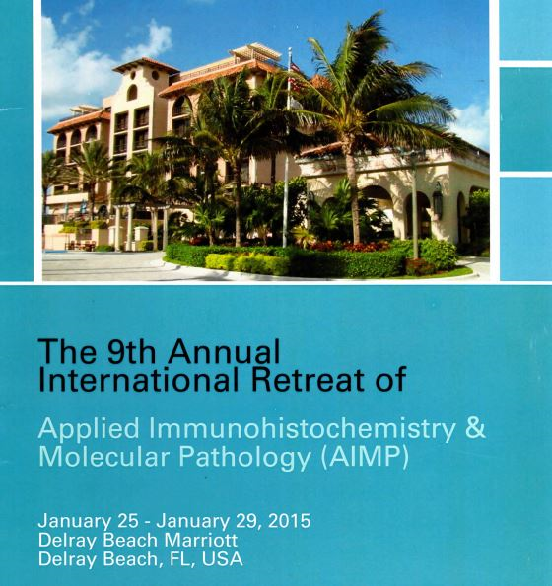
“Use of immunohistochemistry for the detection of gene alterations.
Is there a future for IHC in the Molecular Era?”

Slide 30
IHC Detection of Genomic Alterations
ALK
ROS1

Slide 31
IHC Detection of Genomic Alterations
EGFR L858R
EGFR Exon 19 Del

Slide 32
EGFR L858R Mutation-Specific mAb
“Proteomic Heterogeneity”
Clone 43B2 20x

Slide 33
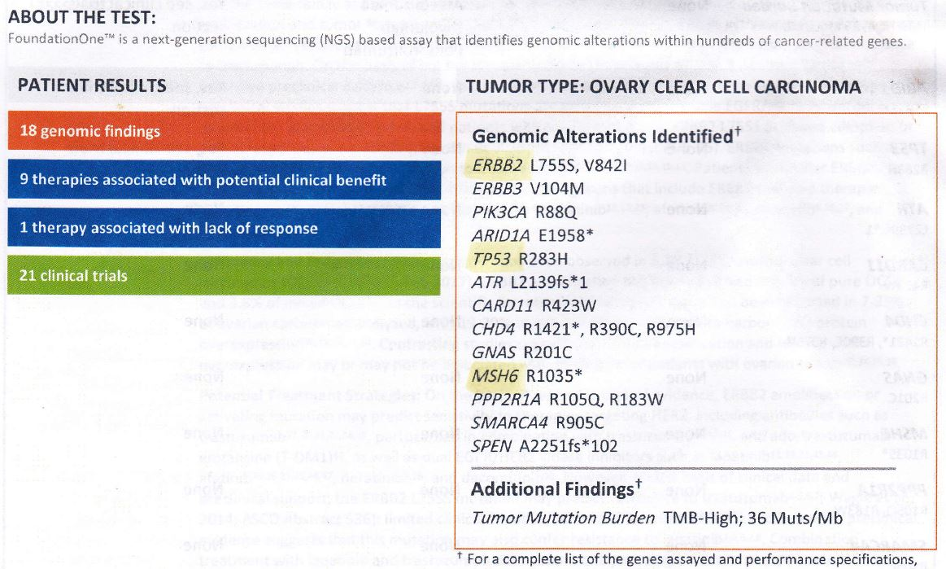

Slide 34
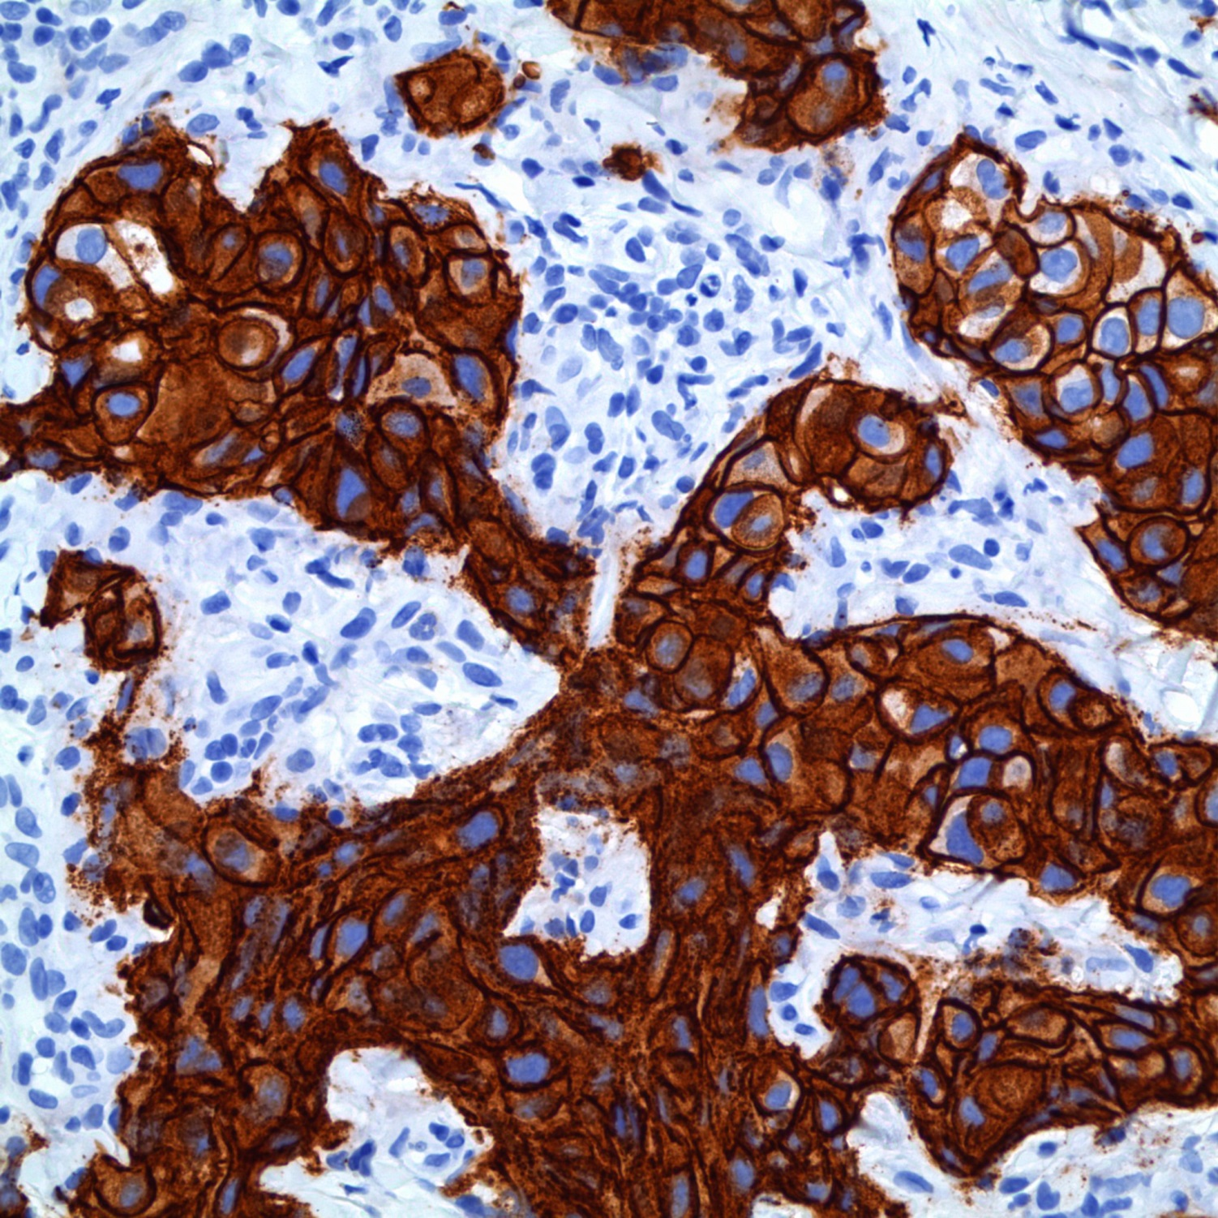
HER2 IHC +Control 40x

Slide 35
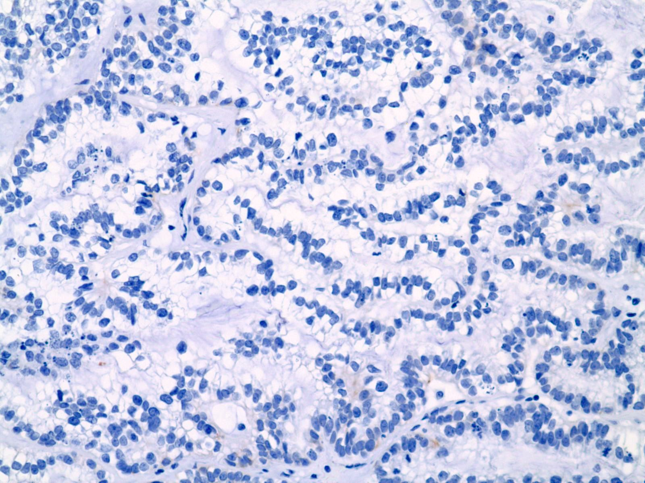
HER2 IHC 40x

Slide 36
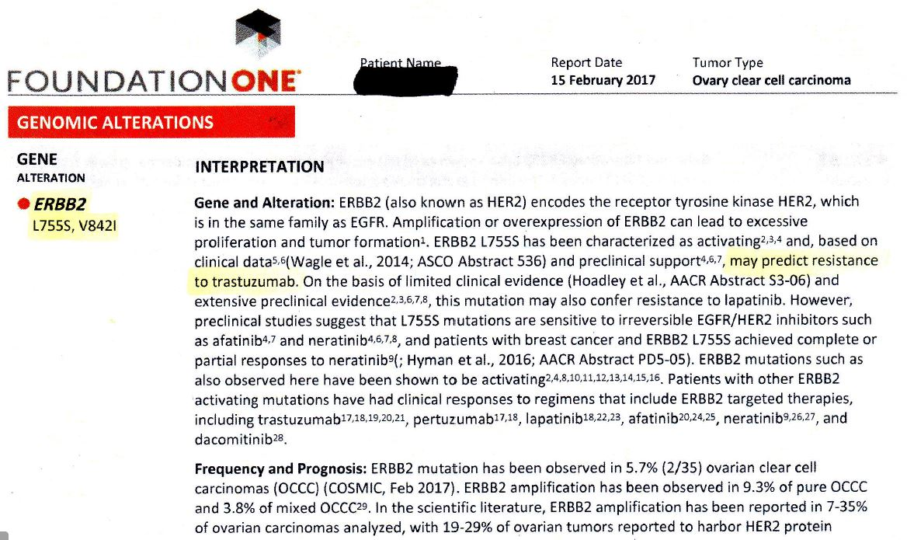

Slide 37
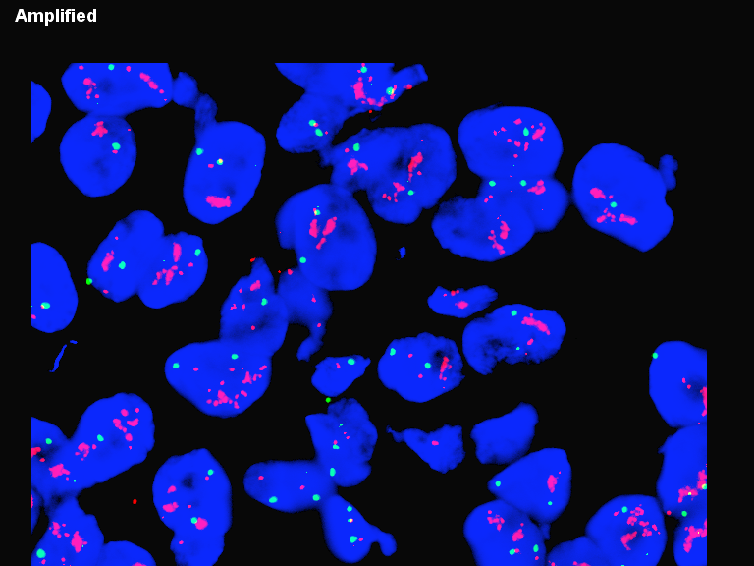
HER2 FISH

Slide 38
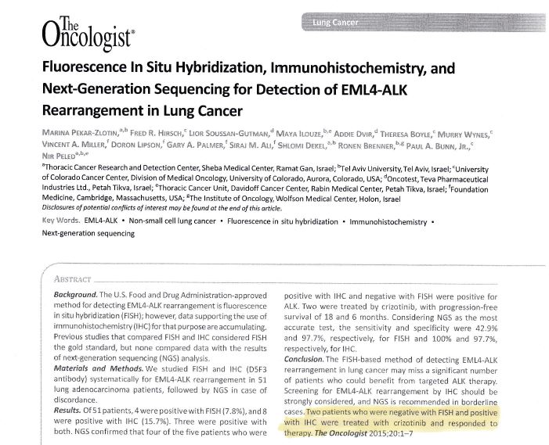

Slide 39
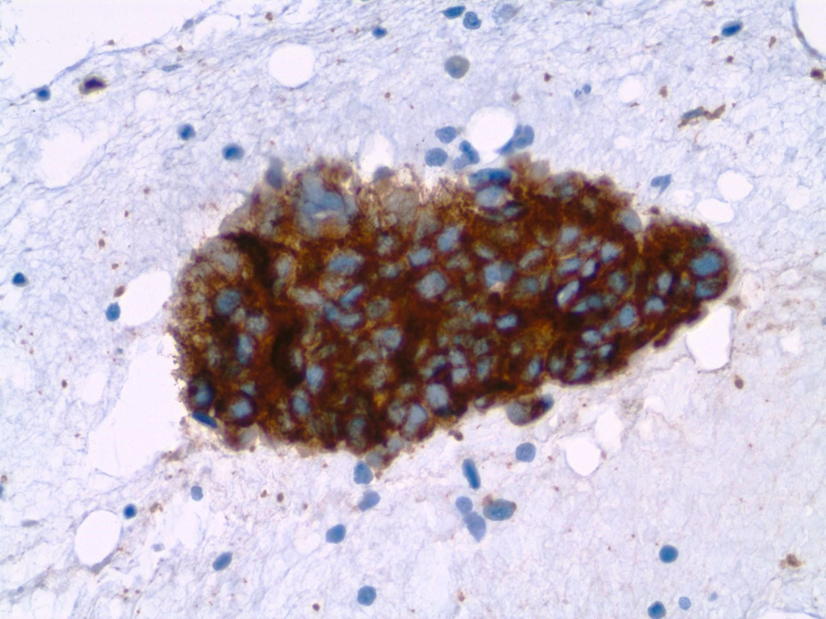
Neuroblastoma
ALK Protein Overexpression 40x

Slide 40
“OK, so what is Confirmational Proteomics?”

Slide 41
“….. what is this HER2 IHC slide doing in my box?”

Slide 42
Case Study
54 year-old male
Malignant neoplasm of upper lobe of left lung
Underwent a left upper lobe apical resection
Diagnosis of invasive adenocarcinoma of lung with one positive station 5 lymph node
IHC and molecular testing performed

Slide 44
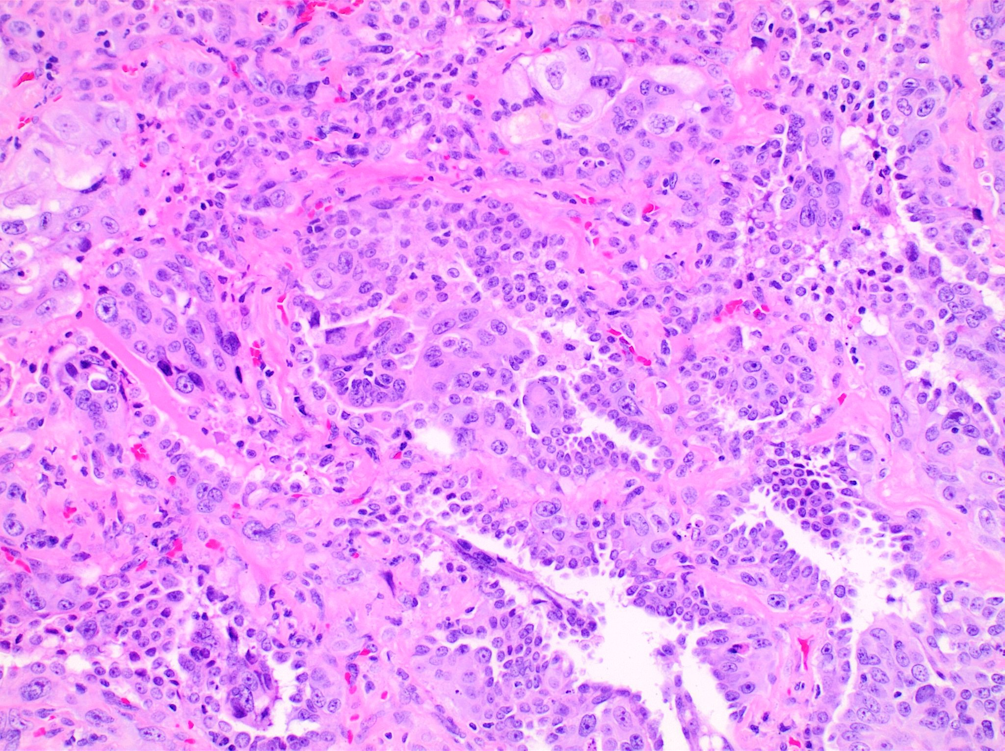
H&E 20x

Slide 45
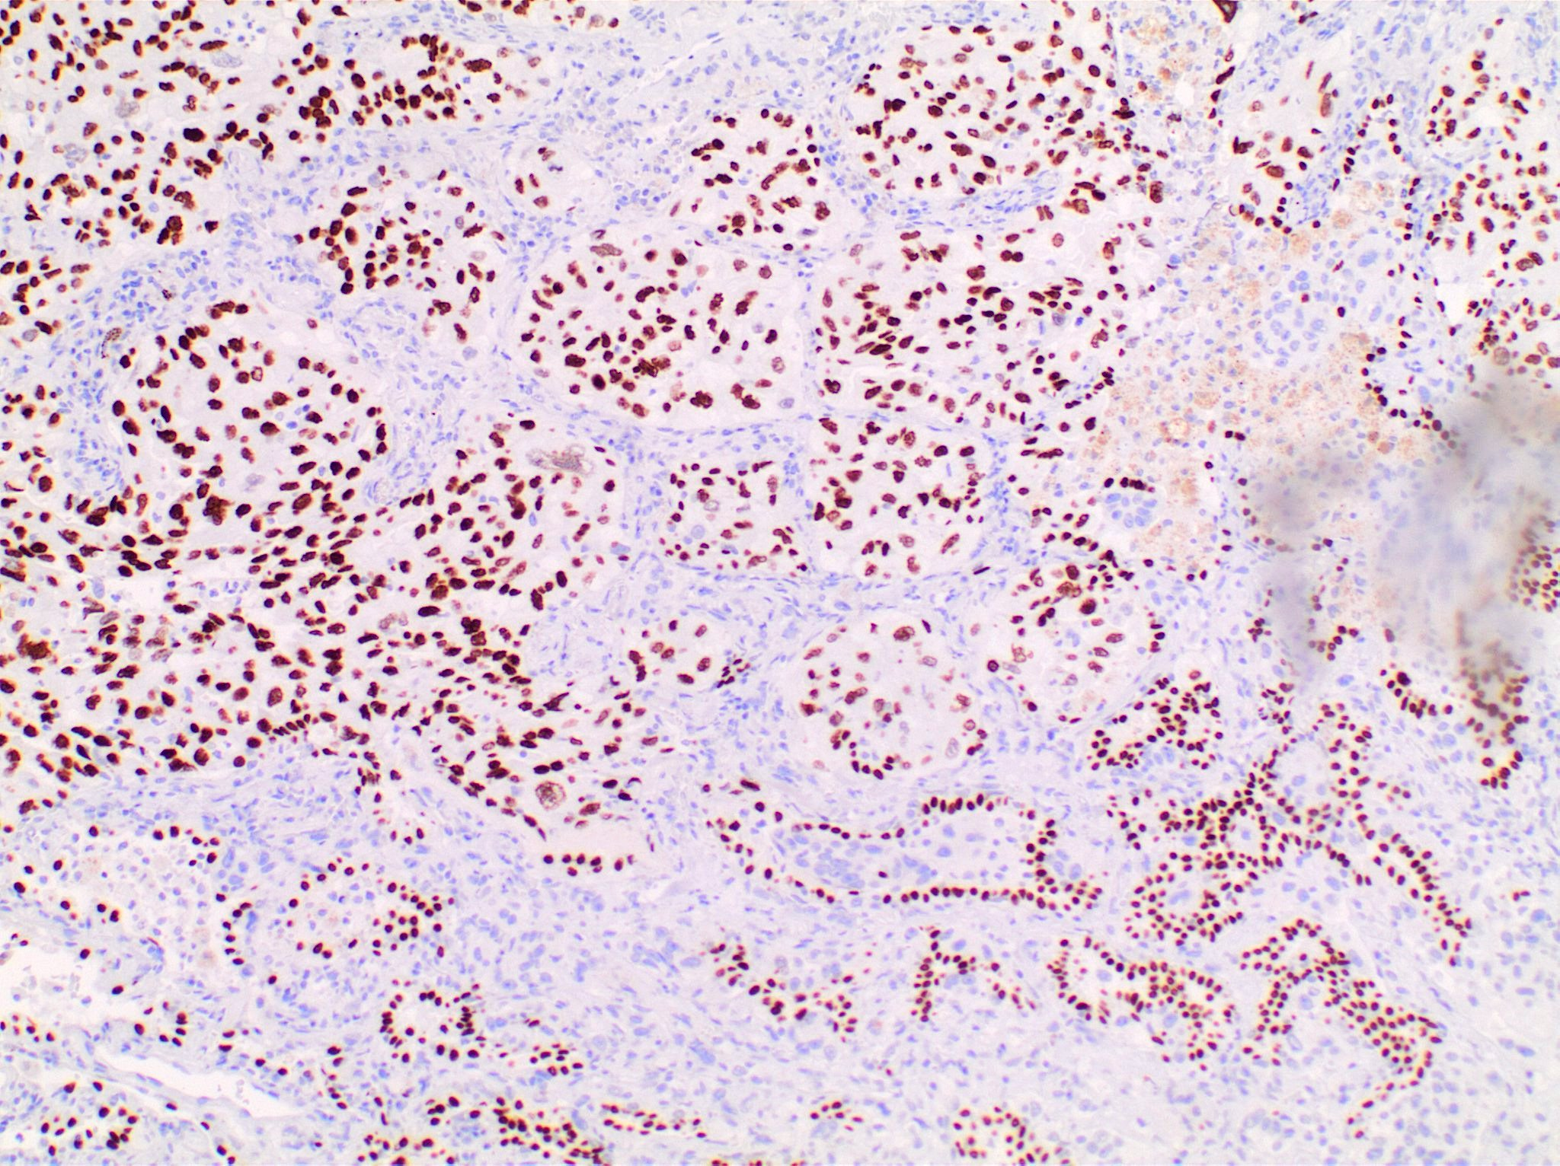
TTF-1 20x

Slide 46
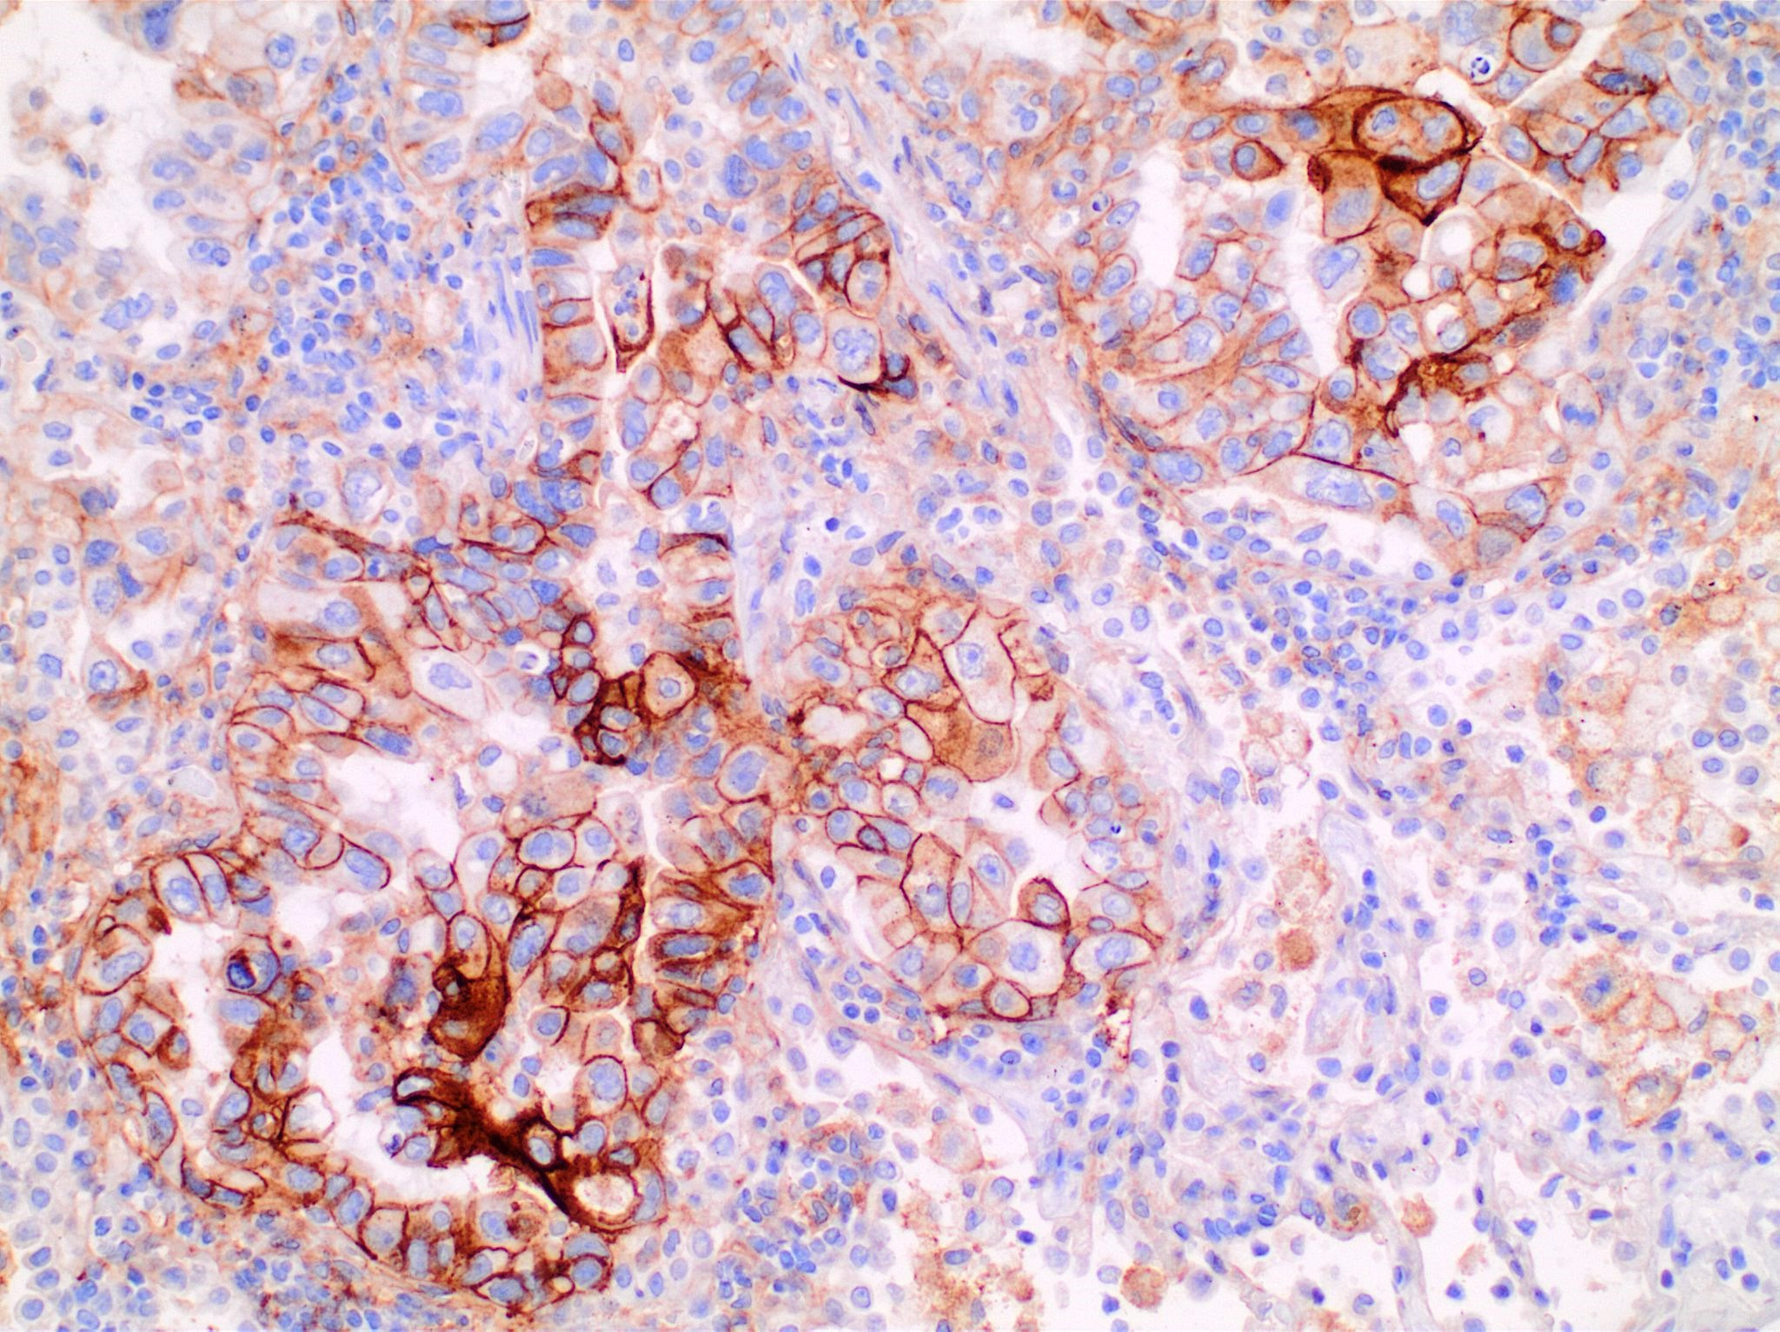
“High Expression” (≥50%)
PD-L1 (clone E1L3N) 20x

Slide 47
“One H&E-stained slide (marked by pathologist) and 5 H&E-stained slides (no coverslips) were submitted to our Molecular Pathology Laboratory for next generation sequencing (NGS) and RNA fusion panel testing.”

Slide 48
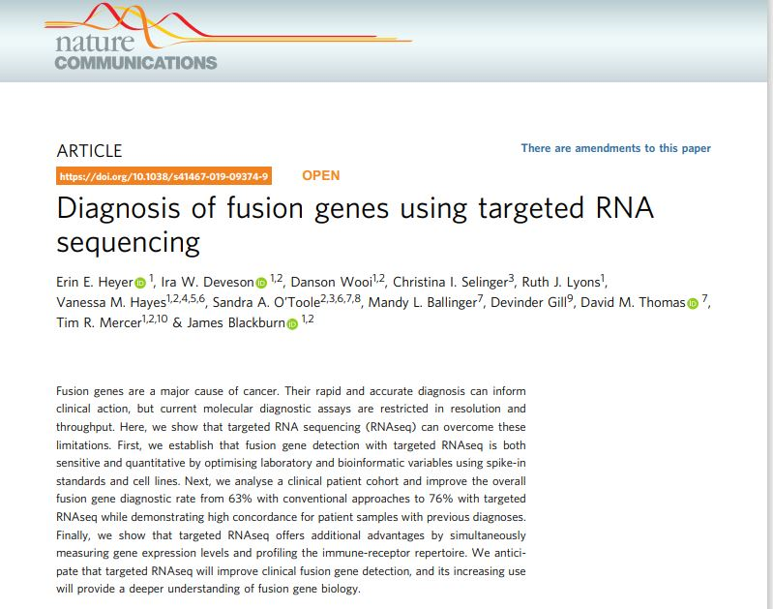

Slide 49
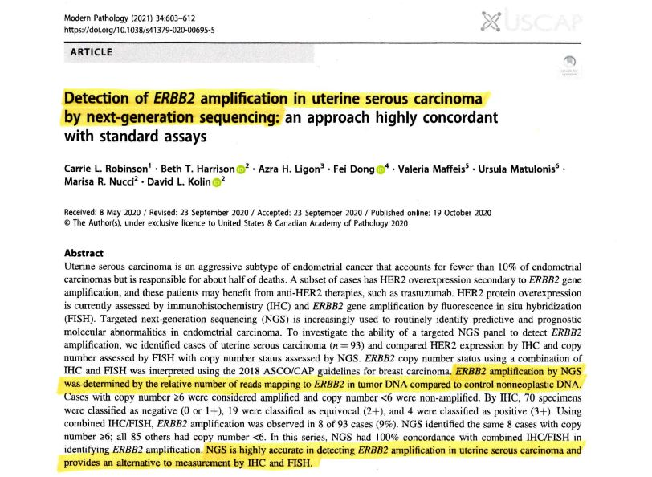

Slide 50
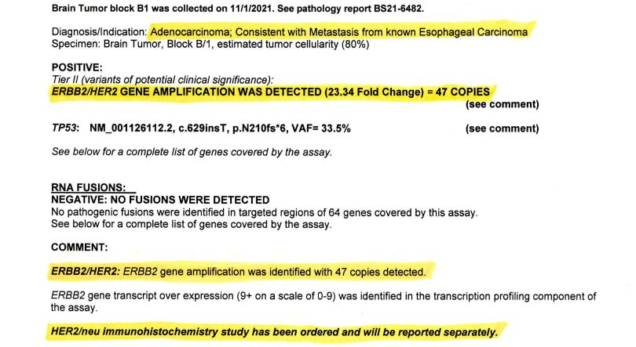

Slide 51
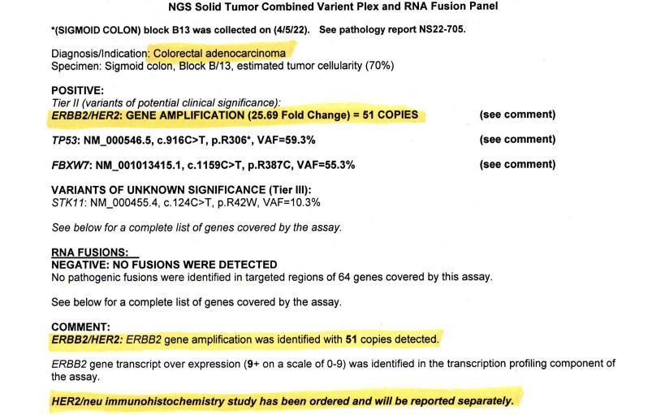

Slide 52
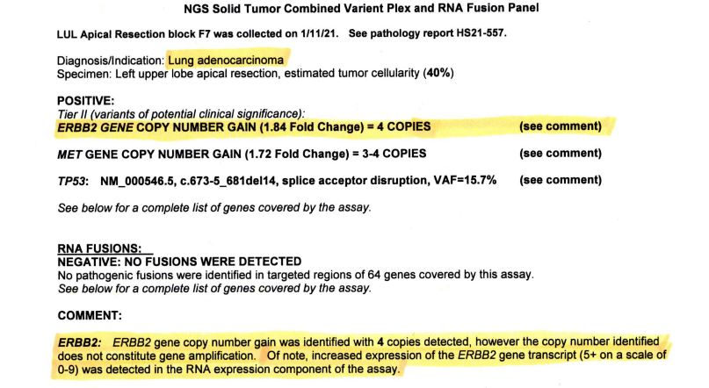

Slide 53
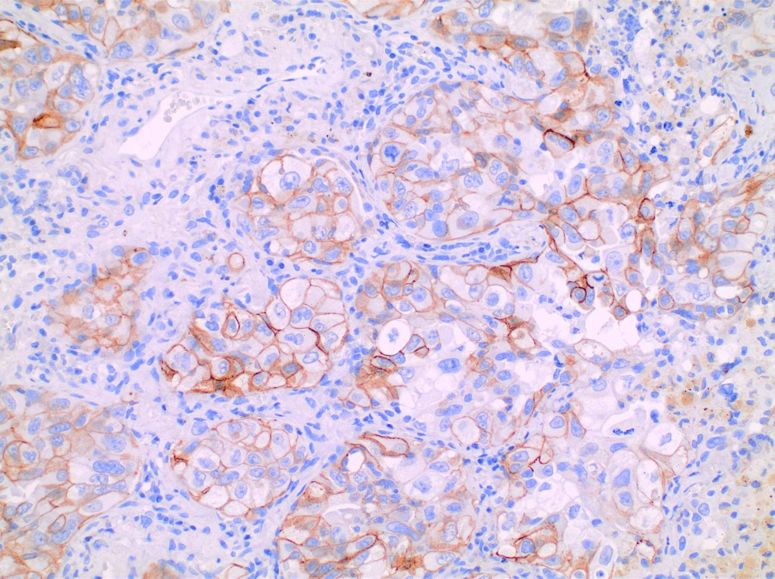
HER2 IHC “F4” 20x

Slide 54
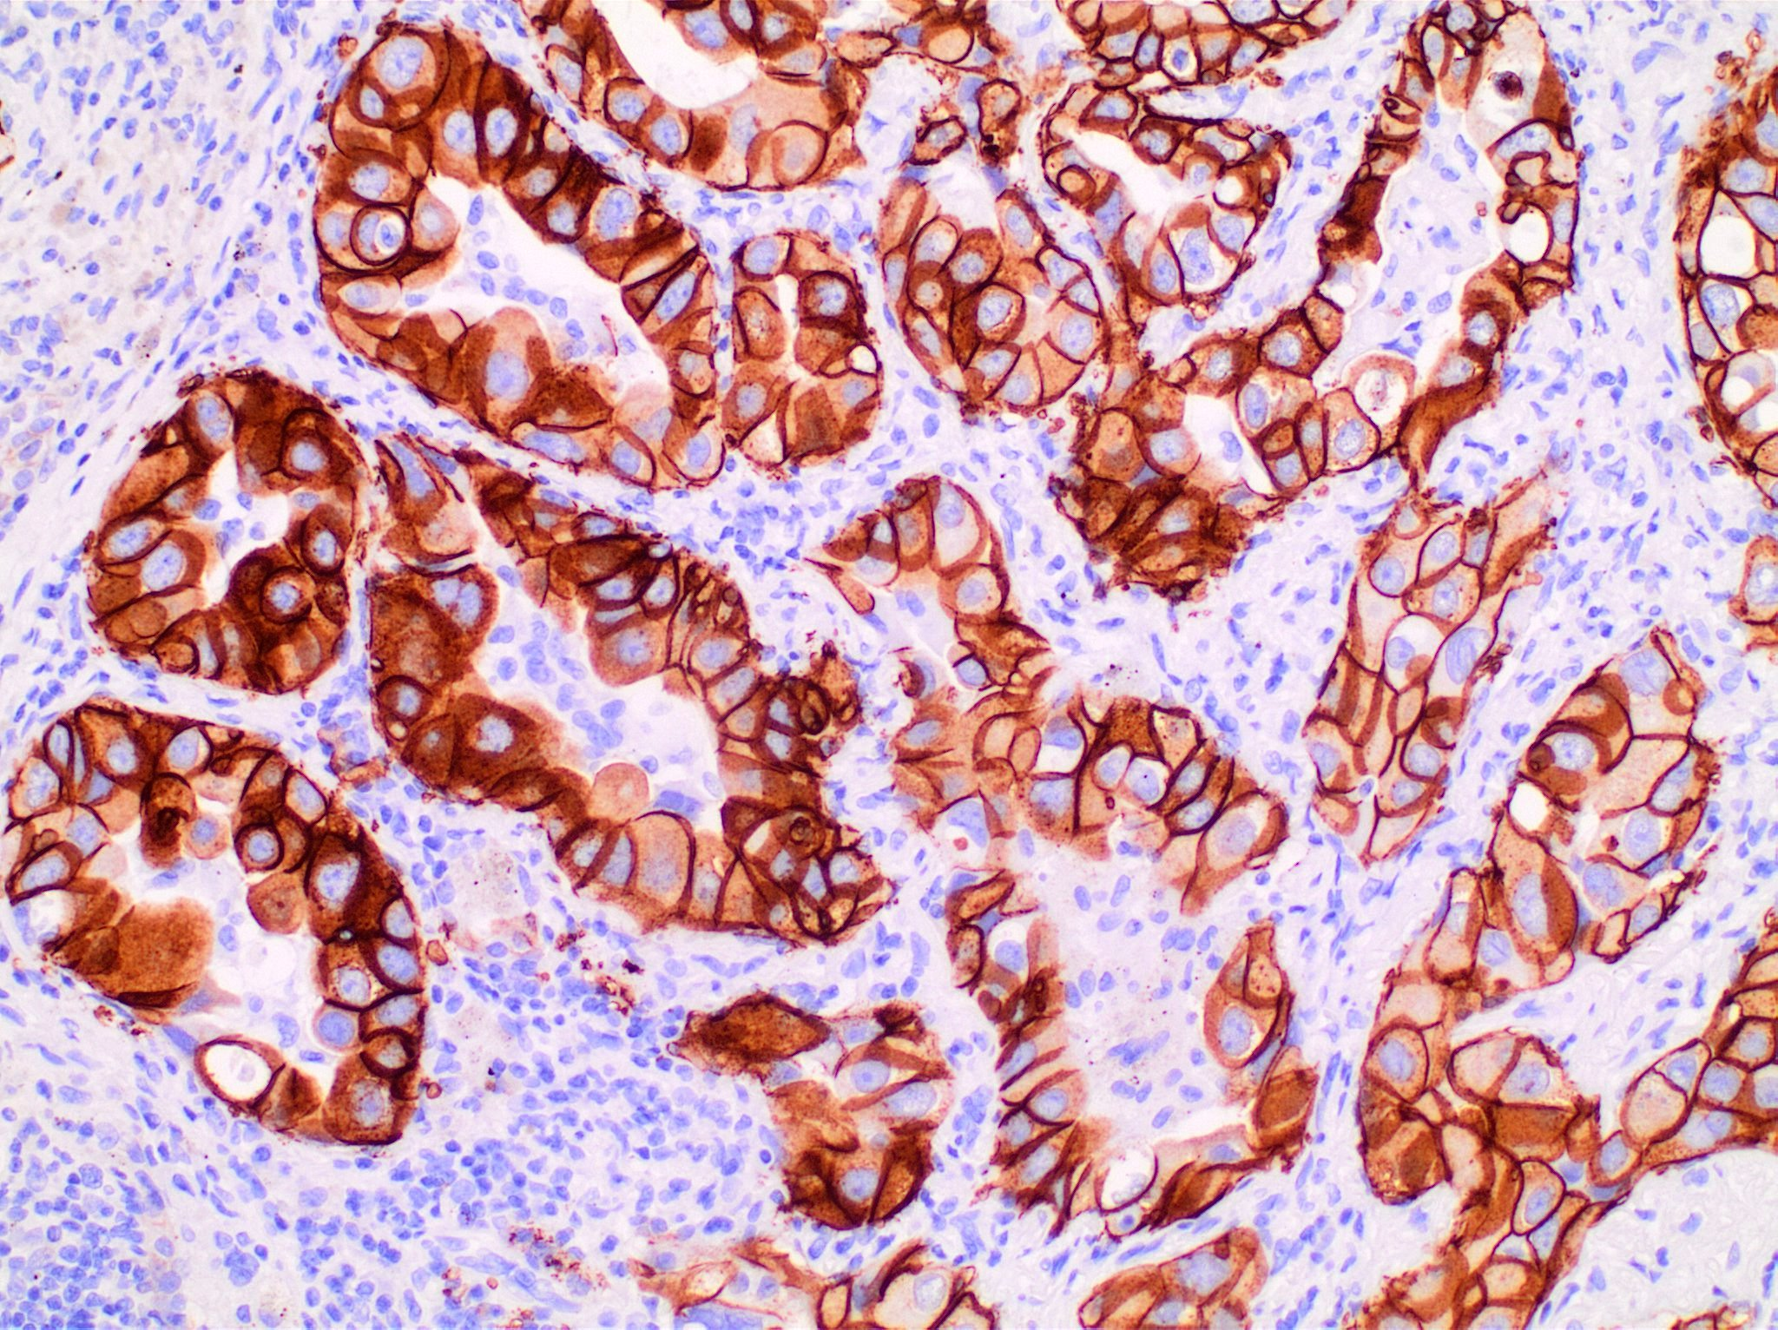
HER2 IHC “F7” 20x

Slide 55
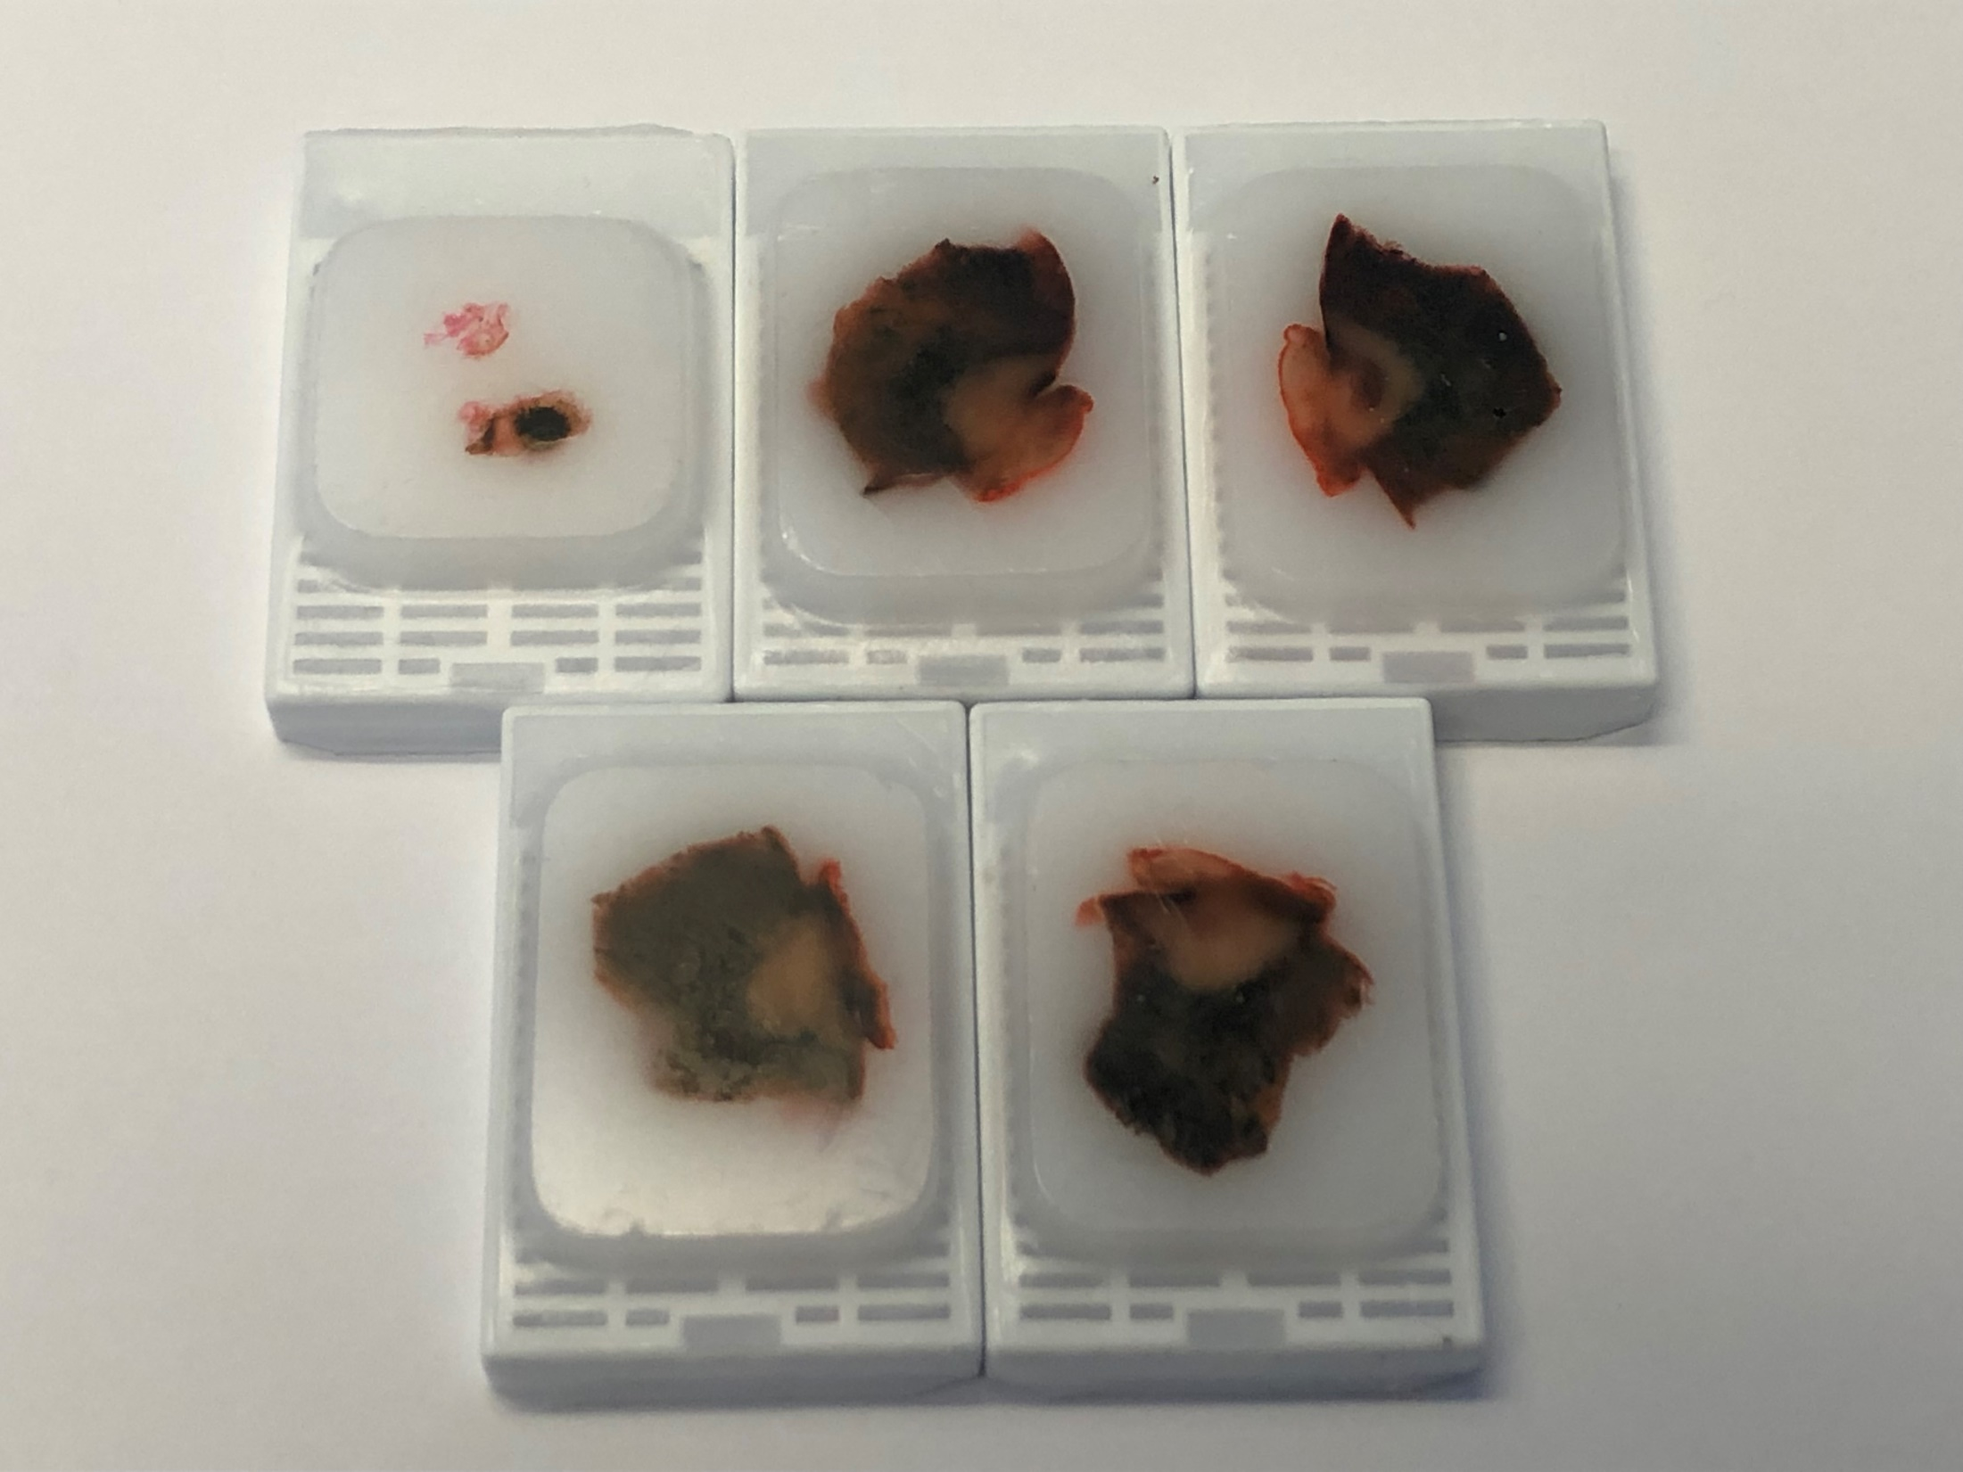

Slide 56
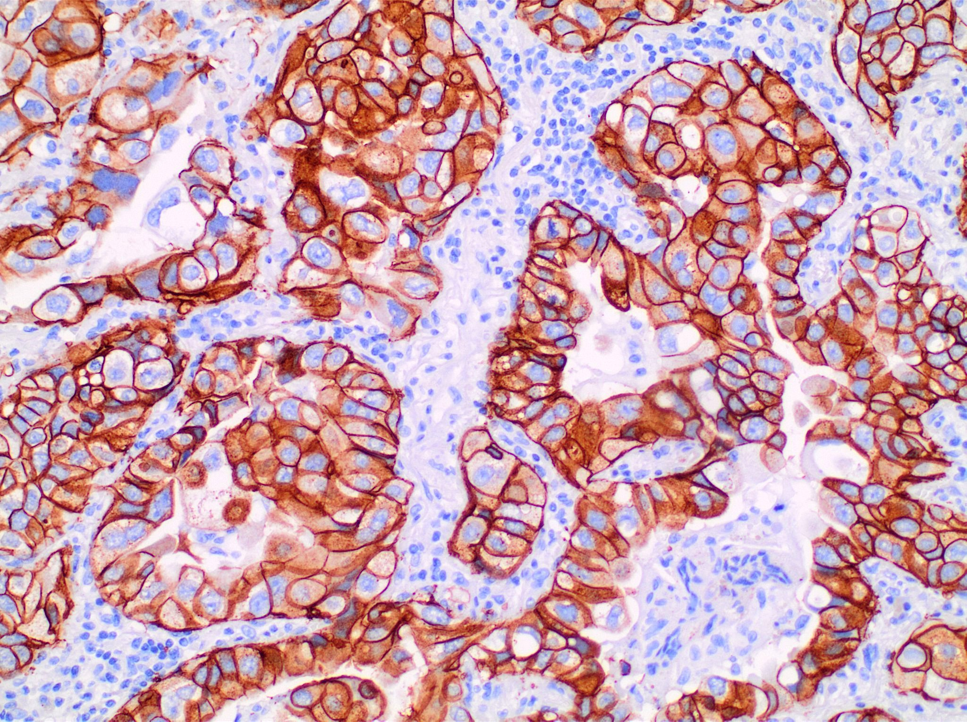
HER2 IHC “F6” 20x

Slide 57
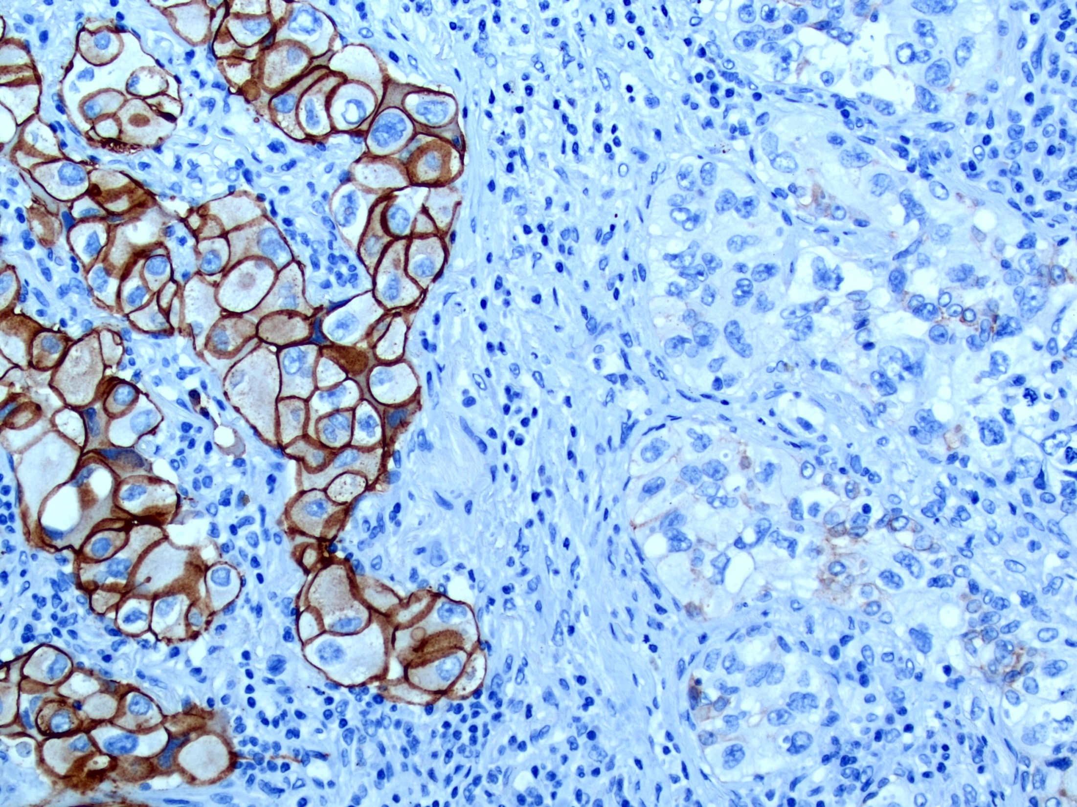
HER2 IHC “F6” 20x

Slide 58
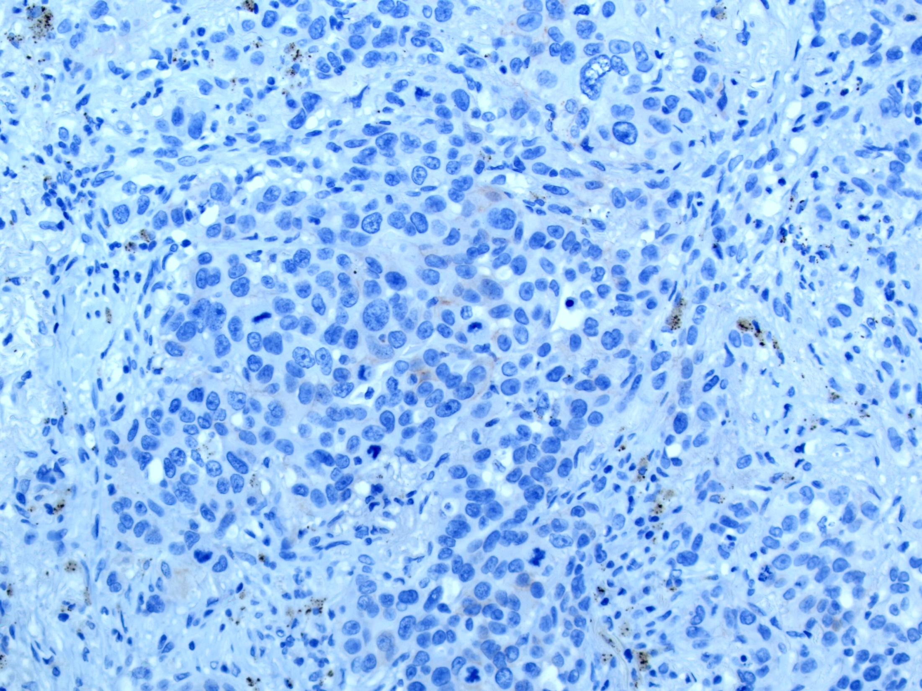
HER2 IHC “F5” 20x

Slide 59
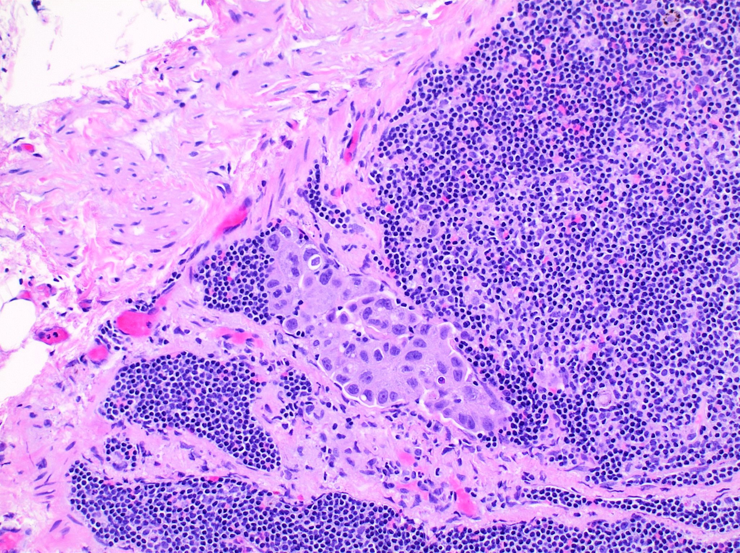
H&E “B1” 20x

Slide 60
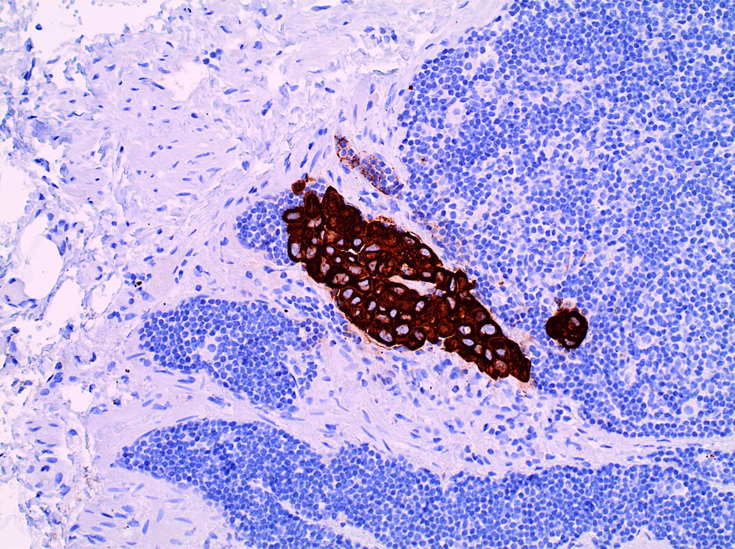
LMW-Keratin (5D3) “B1” 20x

Slide 61
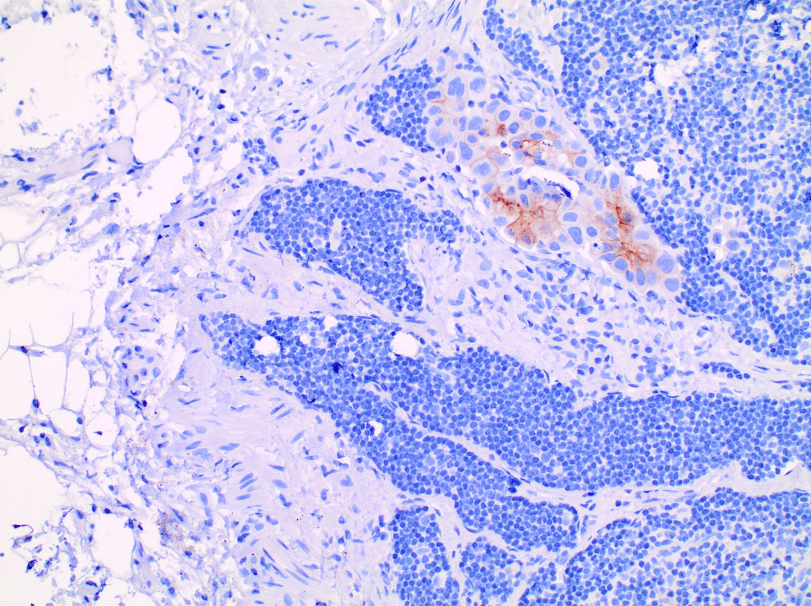
HER2 IHC “B1” 20x

Slide 62
“Confirmational Proteomics”
Immunohistochemical testing identifies protein overexpression that results from genomic alterations, and that serves as a potential target for monoclonal antibody-based targeted therapies.
IHC testing may help to clarify the significance of certain genomic alterations based on the expression or absence of the corresponding protein.
Heterogeneity remains a significant issue for ancillary molecular testing that looks at a small “snapshot” of the patient’s tumor specimen.
Immunohistochemical testing facilitates the evaluation of the entire tumor’s “landscape” for proteomic expression, and, therefore, may help predict response to targeted therapy in patients with residual disease.

Slide 63
“To win the war on cancer, we need to put proteomics on an equal footing with genomics.”
Andreas Hühmer, Director, Thermo Fisher Scientific, USA

Slide 64
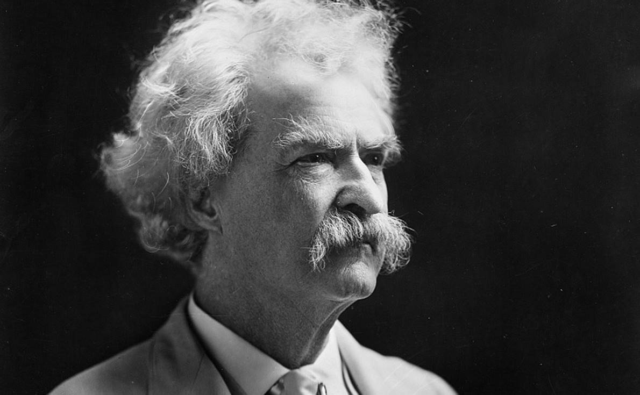
“The reports of my death are greatly exaggerated!”
- Mark Twain

Slide 65
“The reports of Immunohistochemistry’s death are greatly exaggerated!”
- Mark Twain

Slide 66
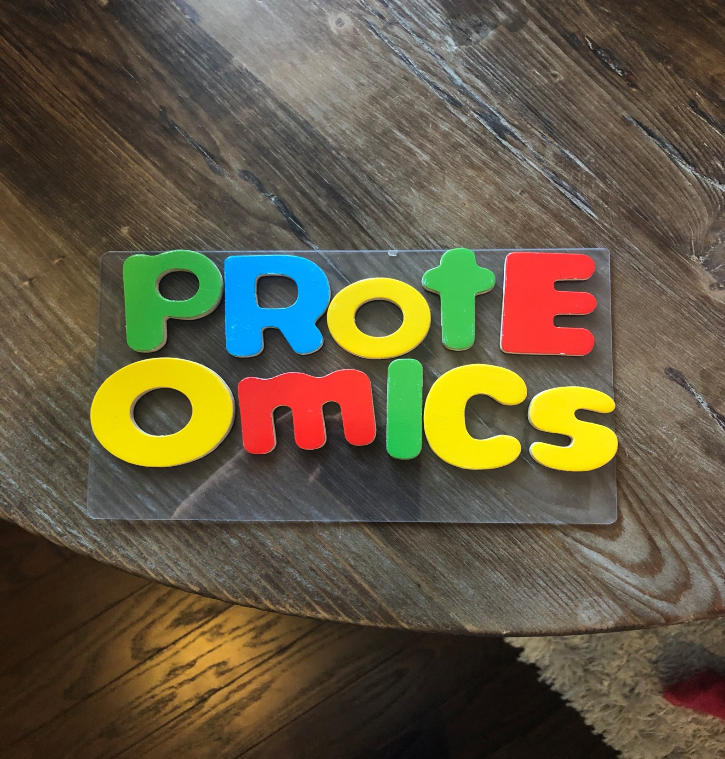

Slide 67
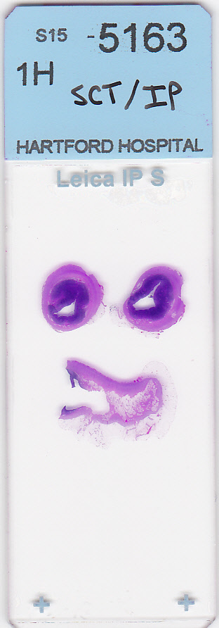
Thank you everyone!

